Slide 1
Hosting Python Apps on PythonAnywhere.com

Slide 2
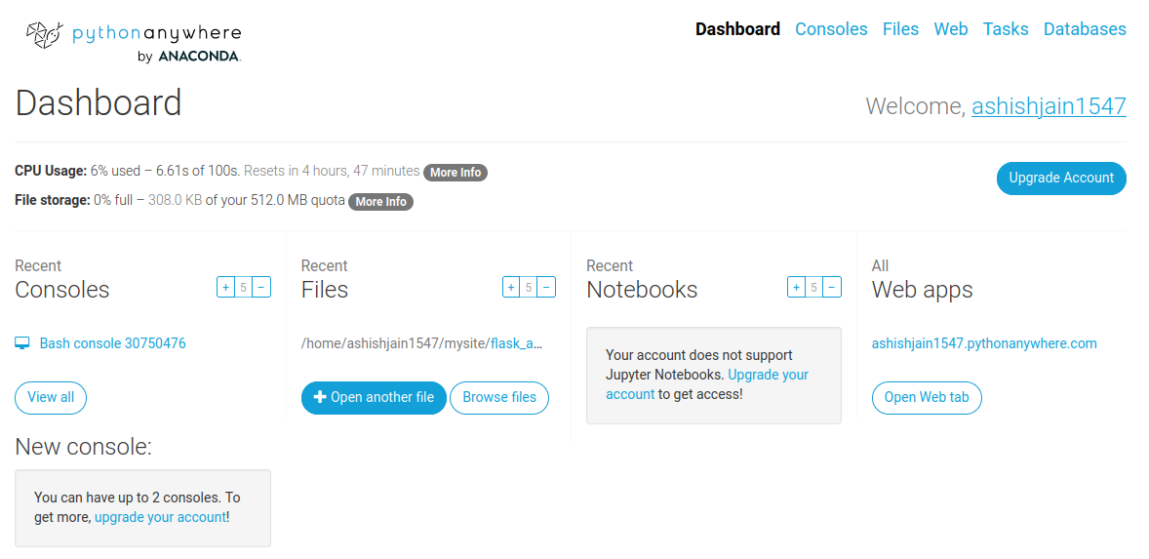
Dashboard UI

Slide 3
With PythonAnywere You Get a Ubuntu Machine to Work on
05:09 ~ $ whoami
ashishjain1547
05:09 ~ $ cat /proc/cpuinfo | grep 'name'| uniq
model name : Intel(R) Xeon(R) Platinum 8175M CPU @ 2.50GHz
05:10 ~ $ cat /proc/cpuinfo | grep process| wc -l
4
05:11 ~ $ uname -a
Linux blue-liveconsole11 5.15.0-1044-aws #49~20.04.1-Ubuntu SMP Mon Aug 21 17:09:32 UTC 2023 x86_64 x86_64 x86_64 GNU/Linux
05:11 ~ $ free -h
total used free shared buff/cache available
Mem: 15Gi 11Gi 886Mi 2.0Mi 2.6Gi 3.1Gi
Swap: 79Gi 31Gi 48Gi
05:12 ~ $ df -h
Filesystem Size Used Avail Use% Mounted on
overlay 73G 5.9G 67G 9% /
10.0.0.33:/mnt/user_storage/homedirs/ashishjain1547/tmp 5.8T 4.9T 719G 88% /tmp
10.0.0.33:/mnt/user_storage/homedirs/ashishjain1547/var/www 5.8T 4.9T 719G 88% /var/www
10.0.0.33:/mnt/user_storage/homedirs/ashishjain1547/home/ashishjain1547 5.8T 4.9T 719G 88% /home/ashishjain1547
10.0.0.10:/homedirs/ashishjain1547/var/log 8.0E 193G 8.0E 1% /var/log
tmpfs 64M 0 64M 0% /dev/shm
05:13 ~ $
05:11 ~ $ ifconfig
bash: ifconfig: command not found

Slide 4
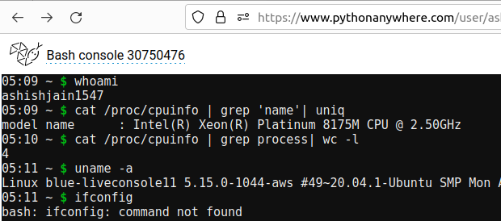

Slide 5
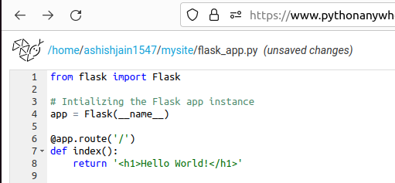
Entry Point of Your Python Code
For me, it is in the file:
/home/ashishjain1547/mysite/flask_app.py

Slide 6
With free account, you get to create one WebApp:
Link to the app is in the following format:
<username>.pythonanywhere.com
For me it is:
http://ashishjain1547.pythonanywhere.com/

